Slide 1

Global Power Generation
2026

Slide 2



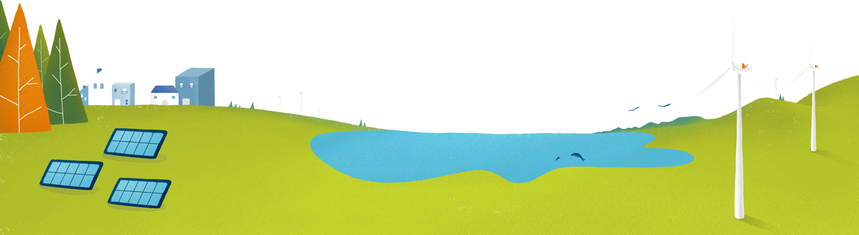
1. About us
Global Power Generation (GPG) is the Naturgy Group subsidiary dedicated to international power generation.
GPG develops and manages generation assets with a global approach, and offers development, construction, operation and maintenance services for its facilities.
Installed
capacity of
5GW
8
Countries
EBITDA
481 M USD
More than
500
employees

Slide 3


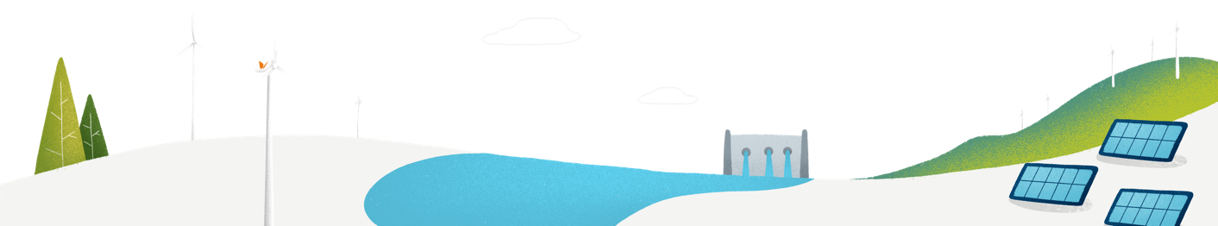
2. Our origin
Global Power Generation (GPG) was set up in 2014 by Naturgy Group and the Kuwait Investment Authority (KIA) through its subsidiary, Wren House Infrastructure.
Naturgy Group
An innovative and sustainable multinational energy group engaged in the generation, distribution, and commercialization of energy and related services. Naturgy operates in more than 20 countries and serves approximately 16 million customers. The company is made up of over 7,000 employees, more than 50% of whom work outside Spain. In addition, it has an installed capacity of 15.9 GW, reported EBITDA₂₀₂₄ of €5.365 billion in 2024, and total assets valued at €40.836 billion.
Kuwait Investment Authority (KIA)
Is the oldest sovereign fund in the world, set up in 1953, and stems from the Kuwait Investment Board. It is responsible for the management and administration of Kuwait’s General Reserve Fund (GRF) and the Future Generation Fund (FGF), as well as other State funds.
75%
25%
Naturgy
KIA

Slide 4
2. Our history
Cabo Leones II wind farm (206 MW) is declared under construction by the National Energy Commission in Chile.
Start of commercial operation of Crookwell 2 wind farm (91 MW), the first operational wind farm in Australia.
Award and signing of the PPA with the Victorian government, in Australia, for the Berrybank 1 wind farm (181 MW).
Signing of the operation and maintenance contract for Achwa II hydraulic power plant in Uganda (41 MW).
Acquisition of the rights and projects from Canadian Solar Inc. for the Guimarânia I (41MW) and Guimarânia II (41MW) photovoltaic plants in Brazil
Establishment of Global Power Generation as a growth vector for the international power generation business. The company is established with 2.3 GW of installed capacity.
Start of commercial operation of Bií Hioxo wind farm (234 MW) in Mexico.
2015
2017
2019
Award and signing of the PPA with the Government of the ACT (Australian Capital Territory) of the Crookwell 2 wind farm (91 MW) in Australia.
Establishment of the GPG Chile Company, starting the “greenfield” development of projects, as well as the search and acquisition of projects at different stages of development.
Start of commercial operation of Torito hydraulic power plant, making GPG the largest private generator in the country with an installed capacity of 100 MW in Costa Rica.
Start of operation of the Sobral I photovoltaic power plant (35 MW) and the Sertão photovoltaic power plant (35MW) in Brazil.
Start of construction of the Crookwell 2 wind farm (91 MW) in Australia.
San Pedro photovoltaic power plant (106 MW) is declared under construction by the National Energy Commission in Chile.
Modernization of units 1 and 2 of La Yeguada hydraulic power plant in Panama, with an additional 1.04 MW capacity increase.
2014
2016
2018

Slide 5
2. Nuestra historia
Start of construction of 11 SSDG (Small-Scale Distributed Generation) photovoltaic plants (56,31 MWp in total), located in Chile.
Start of construction of Crookwell 3 wind farm (58 MW) in Australia.
Start of construction of Ryan Corner wind farm (218 MW) in Australia.
Start of construction of Hawkesdale wind farm (97 MW) in Australia.
Inauguration of ACT Battery (10 MW / 20 MWh) in Australia.
Acquisition of the Cunderdin Hybrid PV Solar + BESS Project (128 MW solar PV capacity and a battery energy storage system of up to 220 MWh) in Australia.
Cessation of O&M activity in Uganda.
Launching of the PMGD Sofía and Soy Solar projects, and the PMG Palermo project in Chile.
10th anniversary of the launching of the Bií Hioxo wind farm (234 MW) in Mexico.
24th anniversary of the launching of the Generation business that led to the development of the Palamara and La Vega power plants in the Dominican Republic.
Financing of GPG Australia’s portfolio for AUD 2.3 billion.
Launching of the Ryan Corner, Hawkesdale and Crookwell 3 wind farms in Australia.
Launching of the Cunderdin Hybrid PV Solar + BESS Project, the first hybrid solar and battery storage project in Western Australia.
Award and signing of the PPA for the Hawkesdale wind farm (97 MW) in Australia.
Award and signing of the PPA with the retailer Snowy Hydro for the Ryan Corner wind farm (218 MW) in Australia.
Award and signing of the PPA with the ACT (Australian Capital Territory) government for the Berrybank 2 wind farm (109 MW) in Australia. This PPA is also associated with a 10 MW battery energy storage system located in the ACT.
Start of commercial operation of the Achwa II hydraulic power plant (41 MW) in Uganda.
2025
2021
2023
Start of commercial operation of the Berrybank 1 wind farm (181 MW), the second operational wind farm in Australia.
The CEN (National Electrical Coordination) declares the start of operation of San Pedro photovoltaic plant (106 MW) in Chile.
The CEN (National Electrical Coordination) declares the start of operation of Cabo Leones II wind farm (206 MW) in Chile
10th anniversary of GPG, marking a decade of growth in international renewable generation, business consolidation, and a firm commitment to the energy transition.
Start of construction of Glenellen and Bundaberg, two photovoltaic plants in Australia, strengthening the company’s presence and renewable development in the country.
25th anniversary of the launch of the Generation business that led to the development of the Palamara and La Vega power plants in the Dominican Republic.
10th anniversary of the Torito Hydroelectric Power Plant (Costa Rica).
ACT Battery (Australia) starts commercial operation.
Start of commercial operation of the Berrybank 2 wind farm (109.2 MW), the third operational wind farm in Australia.
We have celebrated the 15th anniversary of our activity in Australia.
We have celebrated the 25th anniversary of the signing of the first PPA in Mexico (Hermosillo combined cycle power plant).
Entry into commercial operation of SSDG: Milan A & B Torino, Cauquenes, Ratulemus, Cantera, Olivier, Olivia and Los Nogales (41 MWp in total), located in Chile.
2020
2022
2024

Slide 6
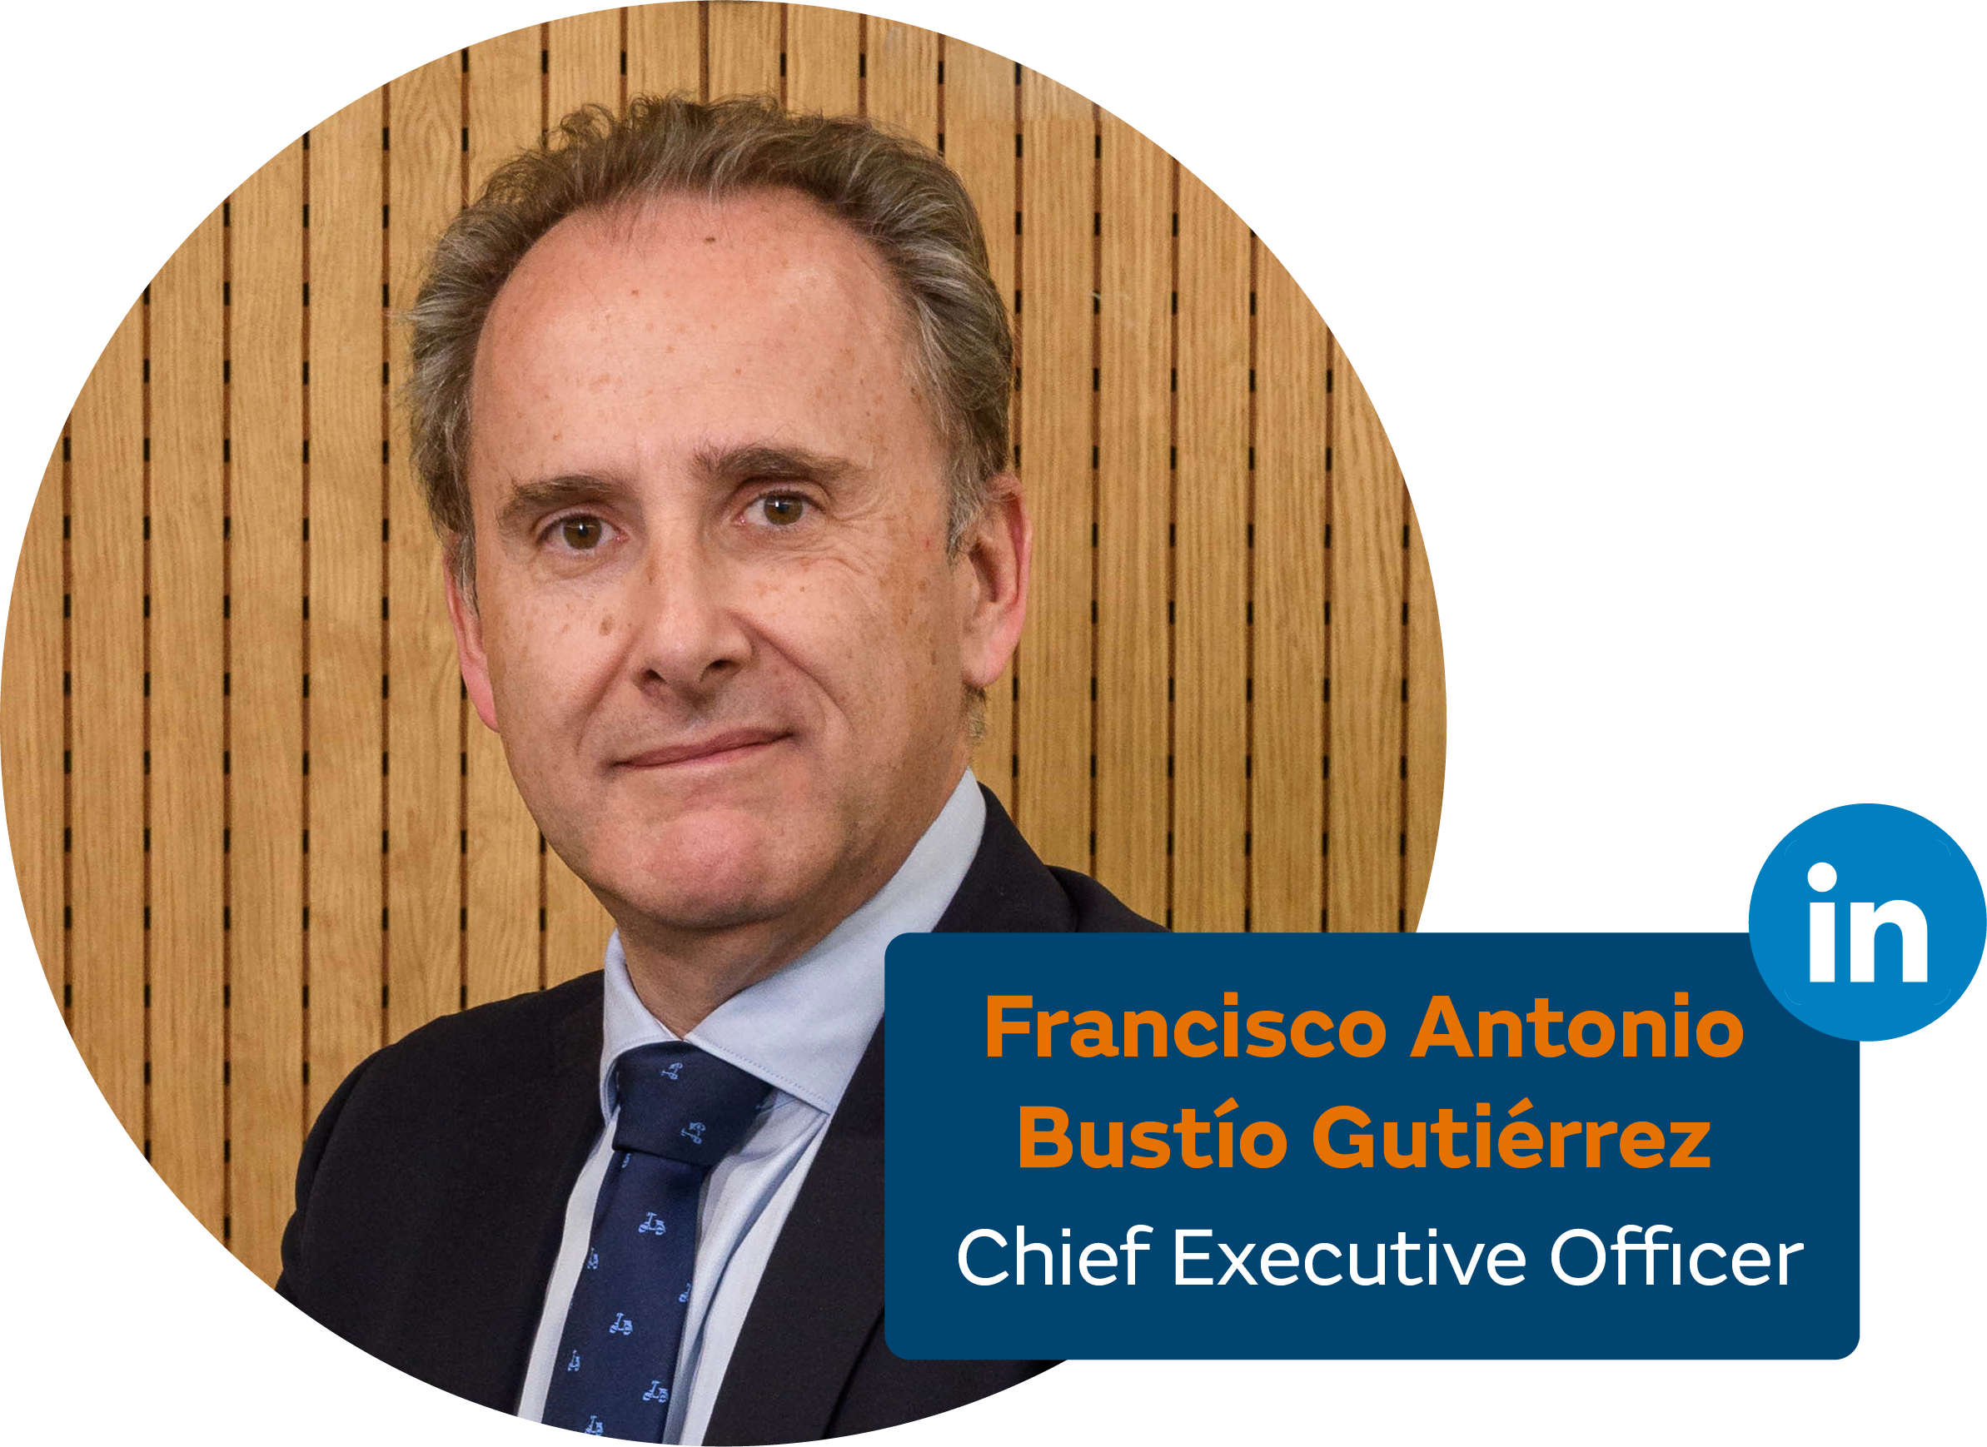
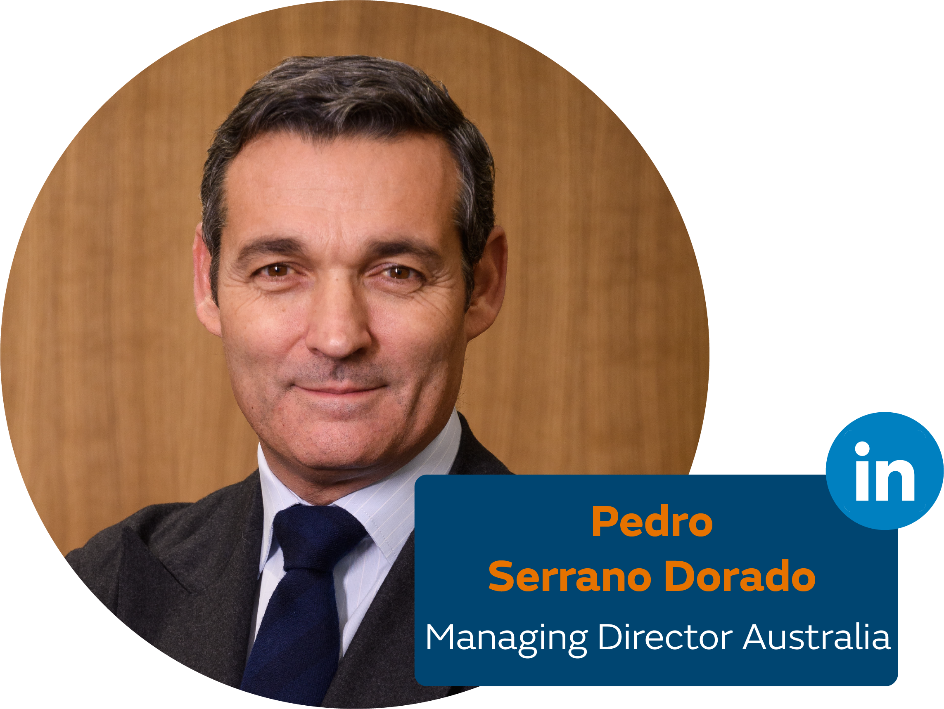
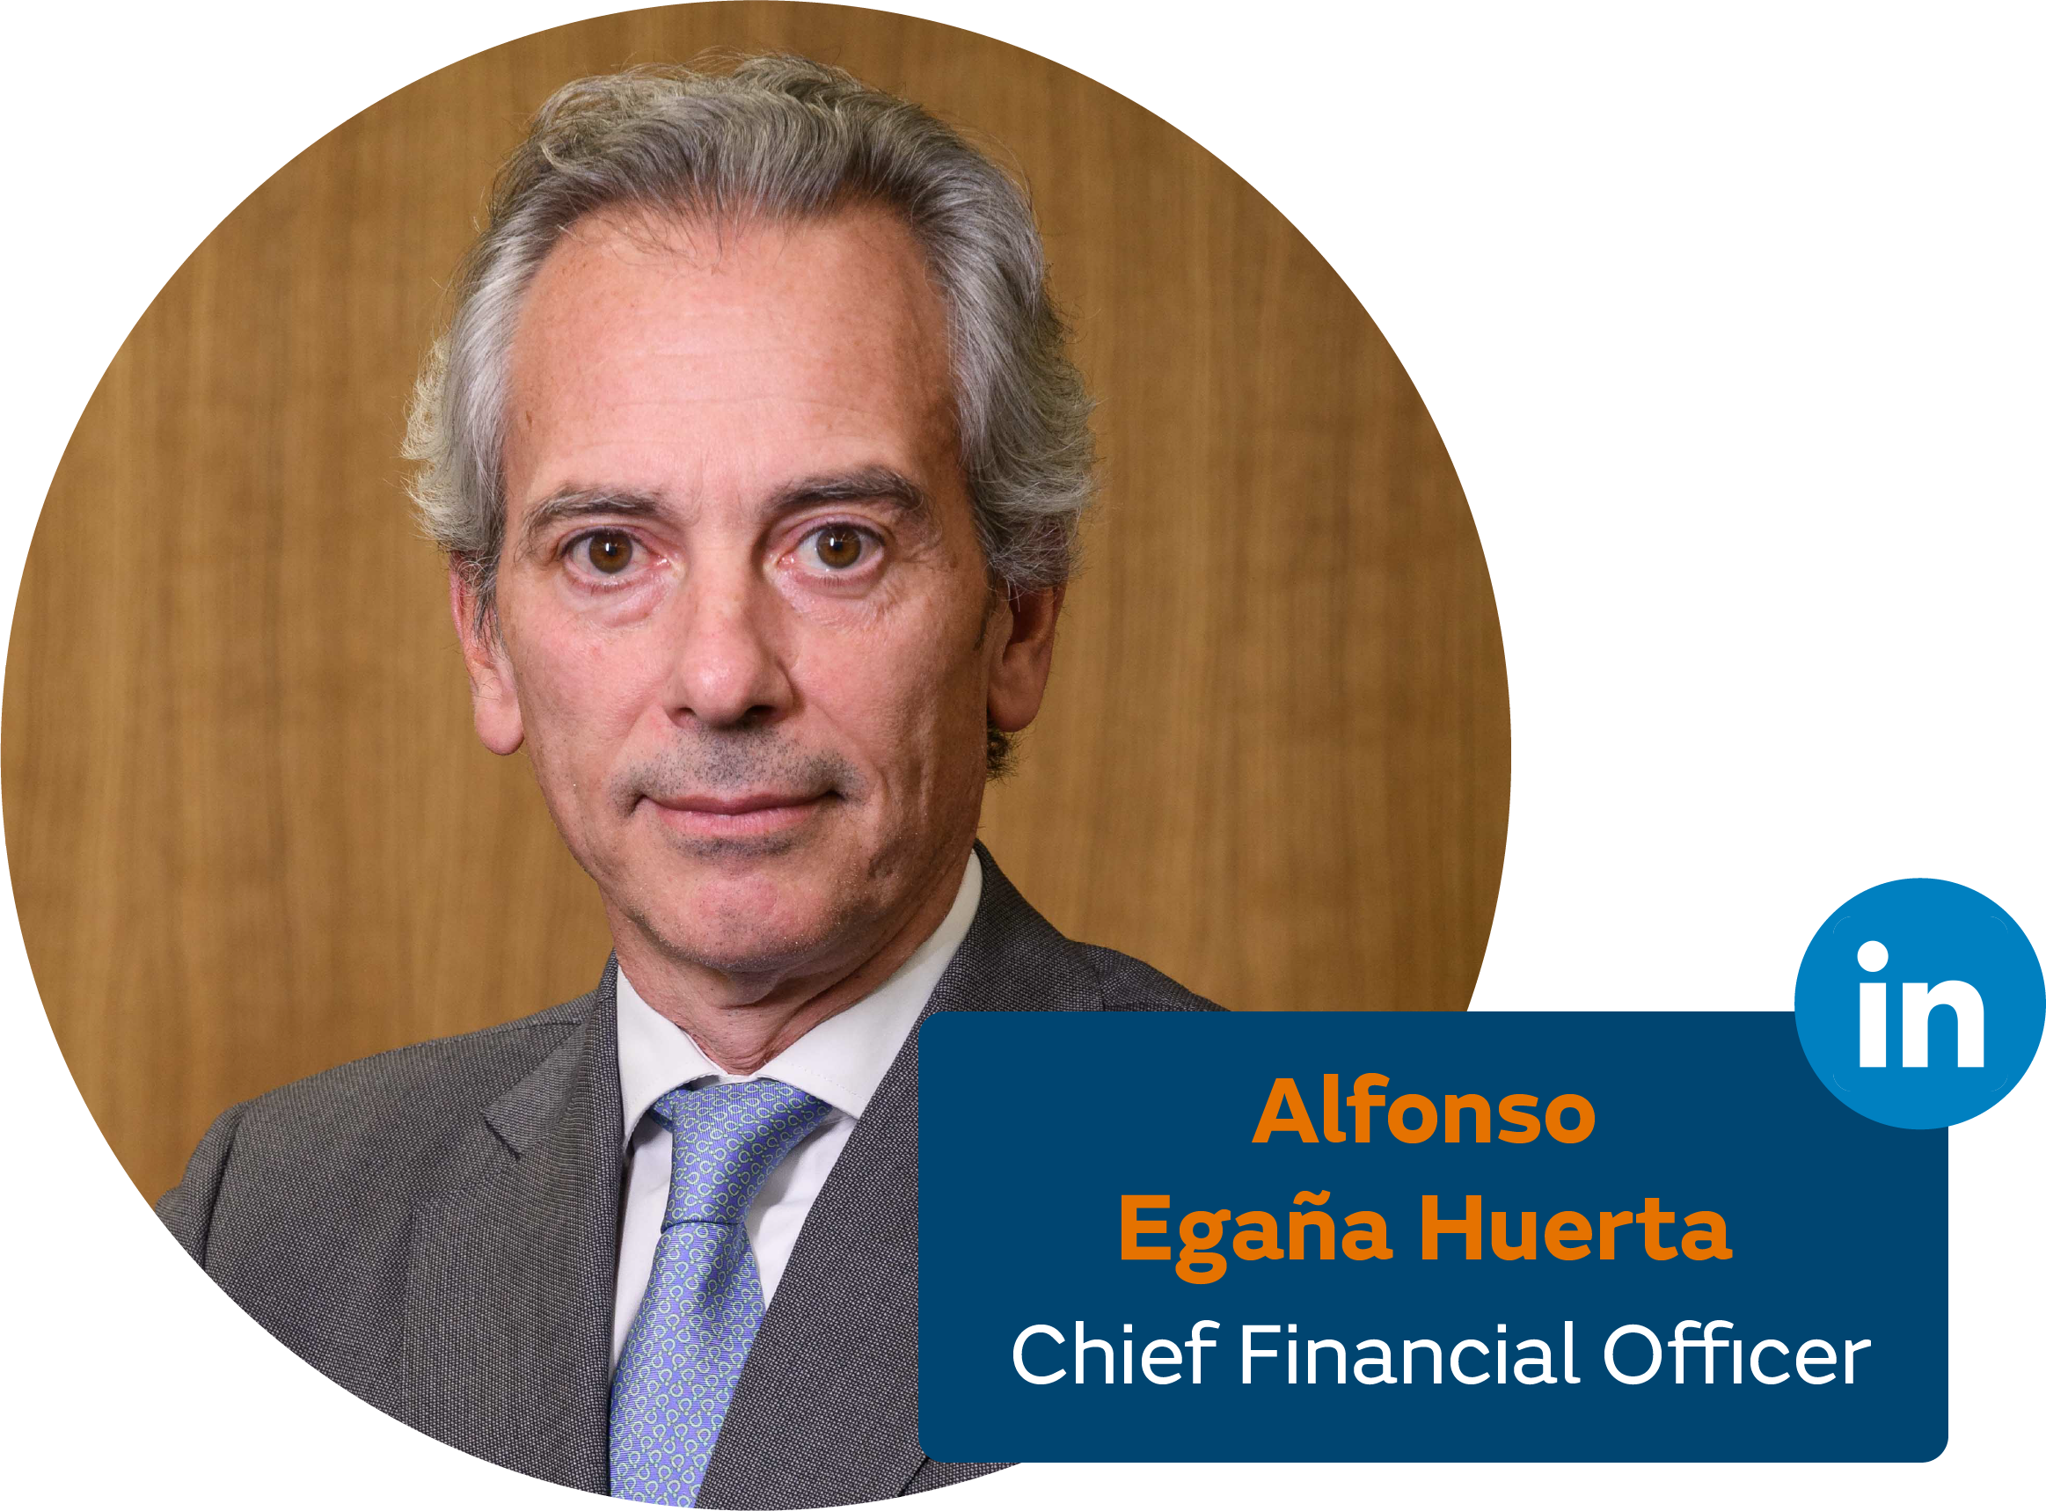
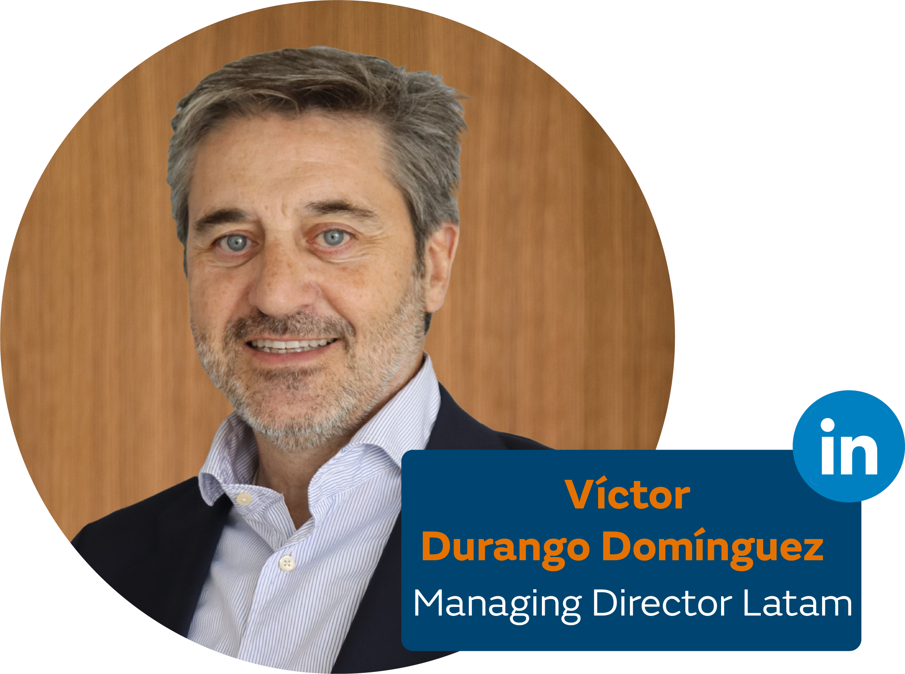
3. Our executive team

Slide 7
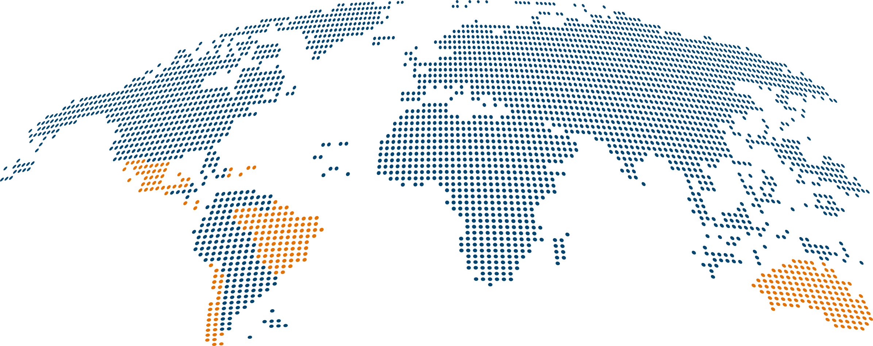







4. Our international presence
5 GW
Activities in 8 countries
Dominican Republic
Puerto Rico
Installed capacity in operation 4,912 MW
Power under construction 360 MW
Total operation + construction 5,273 MW
Mexico
Costa Rica
Brazil
Panama
Chile
Australia
* at the end of the first semester of 2025
Wind power
We have an installed wind power capacity of 234 MW in Mexico, 206 MW in Chile and 758 MW in Australia.
Solar power
Our photovoltaic projects are mainly located in Brazil and Chile with a total power of around 315 MW.
Hydropower
We have a total of 72 MW of installed capacity in our installations in Costa Rica and Panama.
Combined cycle
We have an installed capacity at combined cycle power plants of 2,398 MW in Mexico and 540 MW in Puerto Rico. We also operate one 516 MW power plant for an external client in Mexico.
Thermal plants
We have a total of 190 MW in thermal power plants in the Dominican Republic.
Storage
We have a 10 MW / 20 MWh standalone battery energy storage system and a 55 MW / 220 MWh PV+BESS system in Australia.
Installed capacity
1,198 MW
Installed capacity
315 MW
Installed capacity
72 MW
Installed capacity
2,938 MW
Installed capacity
190 MW
Installed capacity
65 MW / 240MWh
Power under construction
488 MW

Slide 8
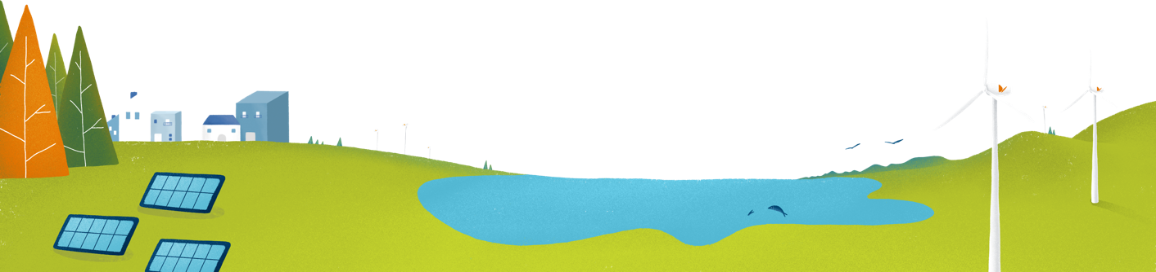
5. Main projects in operation
Tuxpan III & IV combined cycle power plants
Location: Tuxpan, Veracruz (Mexico)
Tecnology: combined cycle power
Installed capacity: 1,180 MW
In operation: since 2003
La Vega thermal power station
Location: La Vega (Dominican Republic)
Tecnology: engine – fuel
Installed capacity: 87.5 MW
In operation: since 2001
Guimarania I & II photovoltaic power plants
Location: Minas Gerais / Guimarania (Brazil)
Tecnology: solar power
Installed capacity: 82 MW
In operation: since 2018
Berrybank 1 wind farm
Location: Corangamite & Golden Plains, Victoria (Australia)
Tecnology: wind power
Installed capacity: 180.6 MW
In operation: since 2021
Bii Hioxo wind farm
Location: Juchitán de Zaragoza, Oaxaca (Mexico)
Tecnology: wind power
Installed capacity: 234 MW
In operation: since 2014
Torito hydraulic power plant
Location Cartago, Turrialba (Costa Rica)
Tecnology: hidropower
Installed capacity: 50 MW
In operation: since 2015
ACT Battery
Location: Canberra ACT (Australian Capital Territory)
Tecnology: storage
Installed capacity: 10 MW / 20 MWh
In operation: since 2022
Berrybank 2 wind farm
Location: Corangamite & Golden Plains, Victoria (Australia)
Tecnology: wind power
Installed capacity: 109.2 MW
In operation: since 2023
Hawkesdale wind farm
Location: Hawkesdale, Victoria (Australia)
Tecnology: wind power
Installed capacity: 96.6 MW
Crookwell 3 wind farm
​​​​​Location: Crookwell,
New South Wales (Australia)
Tecnology: wind power
Installed capacity: 57.6 MW
Ryan Corner wind farm
​​​​​Location: Moyne, Victoria ​​​​​​​(Australia)
Tecnology: wind power
​​​Installed capacity: 218.4 MW
Cunderdin Hybrid PV Solar + BESS Project
Location: Cunderdin, Western Australia ​​​​​​​(Australia)
Tecnology: hybrid solar and battery storage project
​​​Installed capacity: 128 MWac Solar PV +
55 MW / 220 MWh Energy Storage

Slide 9

6. Projects under construction
Glenellen photovoltaic power plant
​​​​​Location: Greater Hume, New South Wale (Australia)
Tecnology: solar power
Installed capacity: 260 MWp Solar PV
Bundaberg photovoltaic power plant
​​​​​Location: Bundaberg, Queensland ​​​​​​​(Australia)
Tecnology: solar power
​​​Installed capacity: 100 MWp Solar PV

Slide 10






7. Acknowledgements of the Naturgy Group
Included running in the sustainability index for the fourteenth year.
Consistently included in the index throughout the last 11 years.
Included in the DJSI Europe for the tenth year running.
Gas distribution sector leader for the fourth year running.
230 in the ranking of the World’s Largest Quoted Companies and fifth in Spain according to Forbes Global 2000.
Bequal Plus seal, distinguishing companies that establish policies exclusively for people with disabilities.
EFR global certified in Human and Social Development.

Slide 11
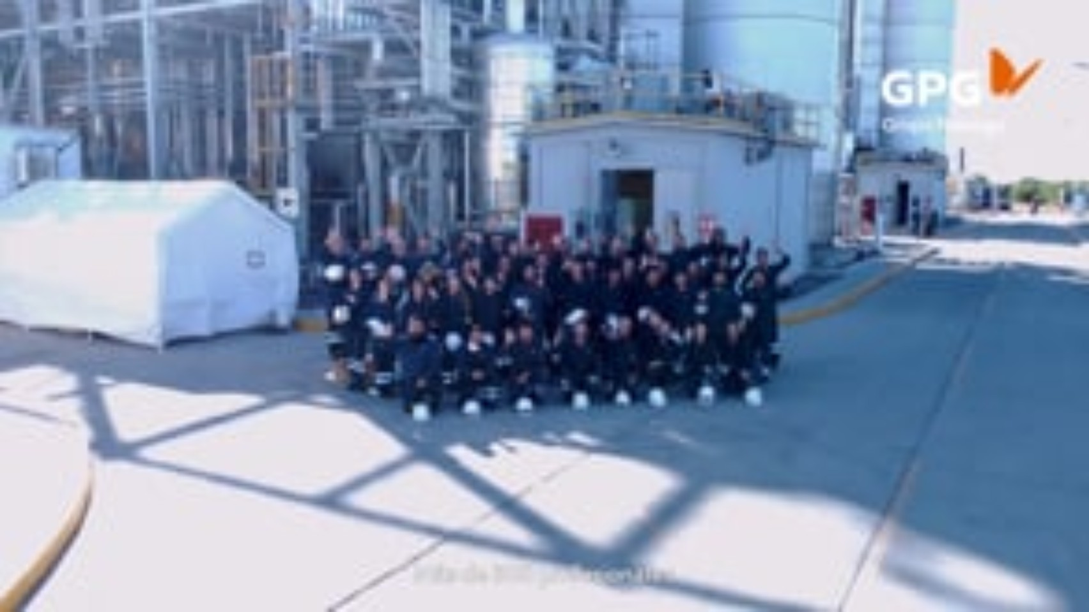

Slide 12


